Slide 1
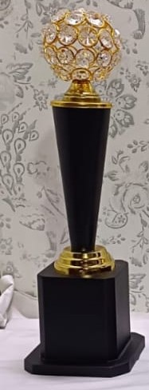


RIICO in collaboration with COSIDICI presents
National Award Function – 2022 for
“Outstanding Entrepreneurs”
Funded By State Level Financial Institutions
{On November 17, 2022 At 6.00 p.m. Hotel Indana Palace, Jodhpur (Rajasthan) }

Slide 2
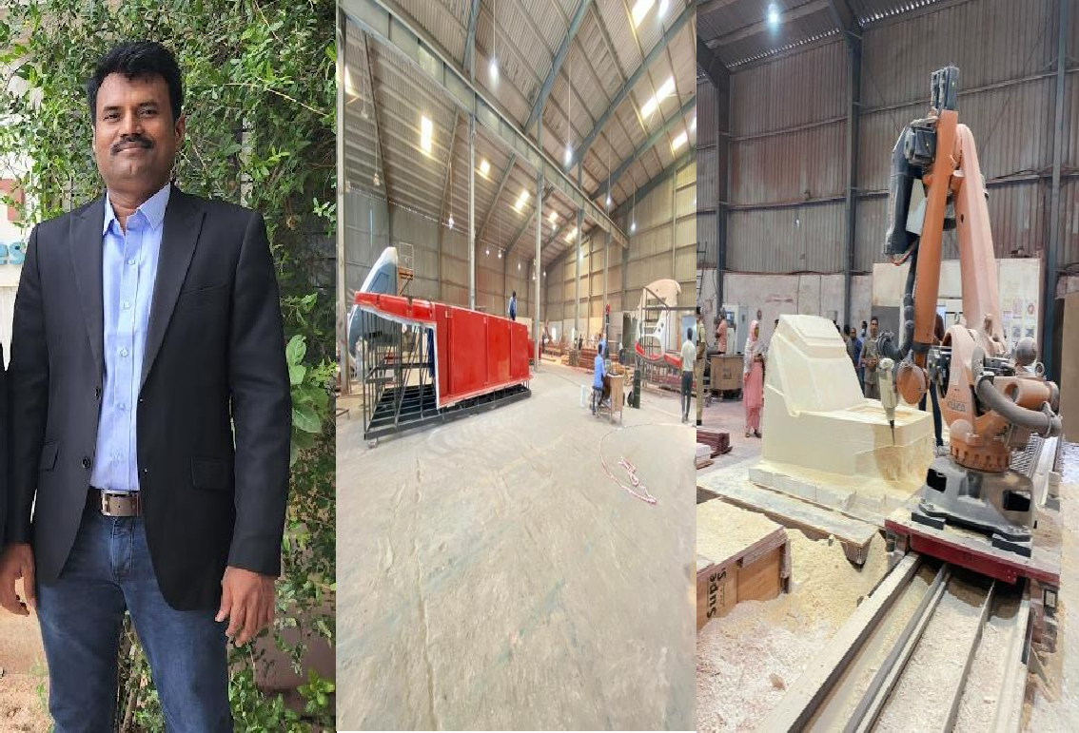
Andhra Pradesh State Financial Corporation {APSFC}, Vijayawada
M/s. Triovision Composite Technologies Pvt. Ltd.
Sri Nandan Reddy MVBS

Slide 3
Andhra Pradesh State Financial Corporation {APSFC}, Vijayawada
M/s. Triovision Composite Technologies Pvt. Ltd.
Shri Nandan Reddy MVBS, established M/s Triovision Composite Technologies Pvt. Ltd. with financial assistance of Rs.340.00 lakhs Term Loan from APSFC. The unit manufactures FRP Components and Tools. The unit started its operations for growing demand of fiber reinforced composite for Indian and Global market. It has been offering Engineering, Tooling, Prototyping and Manufacturing of fiberglass parts under one roof which is a very unique characteristic. The unit has also diversified into various market segments viz. Automotive, Railway, Waterslide (amusement park), Wind and Architecture. Its upcoming plans are to enter into Aerospace and Defence sector. The unit has won several awards from international trade shows. Shri Nandan Reddy MVBS is being conferred with the ‘Best First Generation Entrepreneur’ award.

Slide 4
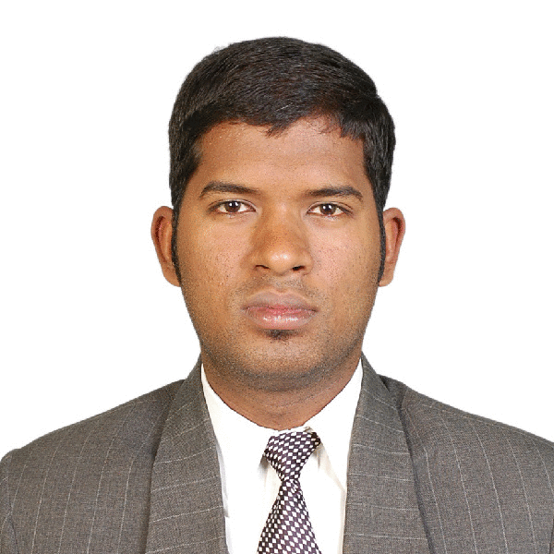
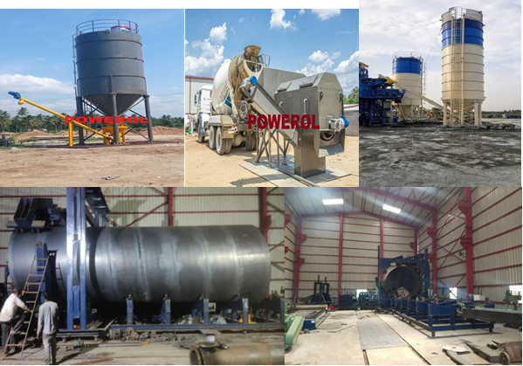
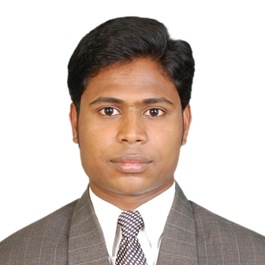
Andhra Pradesh State Financial Corporation {APSFC}, Vijayawada
M/S.Powerol Energy Systems
Shri K. Balaji
Shri N. B. Sarvanan

Slide 5
Andhra Pradesh State Financial Corporation {APSFC}, Vijayawada
M/S.Powerol Energy Systems
Shri K. Balaji and Shri N. B. Sarvanan established M/s Powerol Energy Systems the first MSME company in India to design and develop indigenously India’s First special purpose machinery (SPM) for manufacturing large storage tanks and silos with financial assistance from APSFC. The machinery is self-assembled to reduce the manufacturing time and the labour cost of the silos. The nature of the products and the machinery attracts huge investment and therefore the development in this sector has been limited. This SPM is capable of manufacturing Dia up to 3200mm presently and can be increased upto 3700mm. Shri K. Balaji is receiving the Best Entrepreneur award.

Slide 6
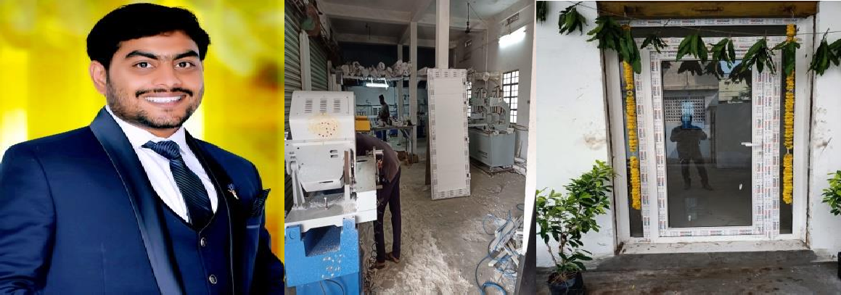
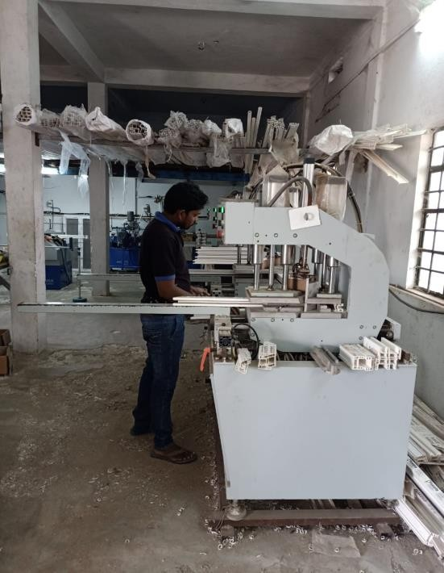
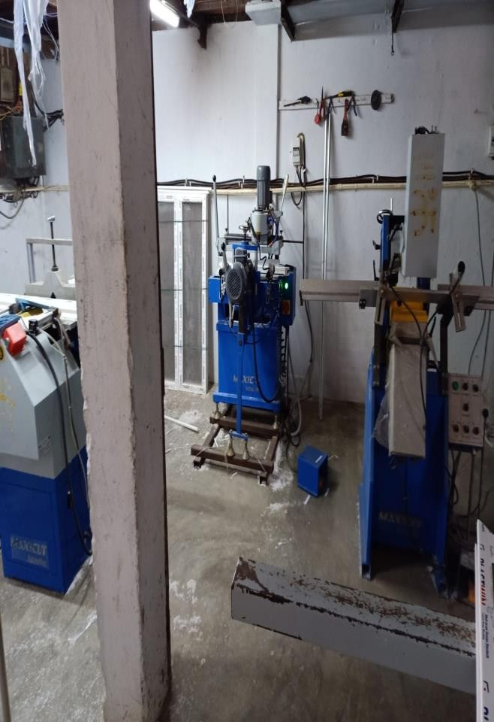
Andhra Pradesh State Financial Corporation {APSFC}, Vijayawada
M/s Satya Sri Parameshwara UPVC Windows & Doors
Shri Marisetti Srinivasu

Slide 7
Andhra Pradesh State Financial Corporation {APSFC}, Vijayawada
M/s Satya Sri Parameshwara UPVC Windows & Doors
M/s. Satya Sri Parameshwara UPVC Windows & Doors was established by Shri Marisetti Srinivasu with the financial assistance of Rs. 30.00 lakhs under Young Entrepreneurs Scheme of APSFC during the year 2019. UPVC Windows & Doors are used in commercial and residential space on a large scale owing to its insulation properties. This is a substitute for wooden doors and windows. Demand for the product is high & is expected to increase further. Shri Marisetti Srinivasu is being awarded as the Best First Generation Entrepreneur.

Slide 8
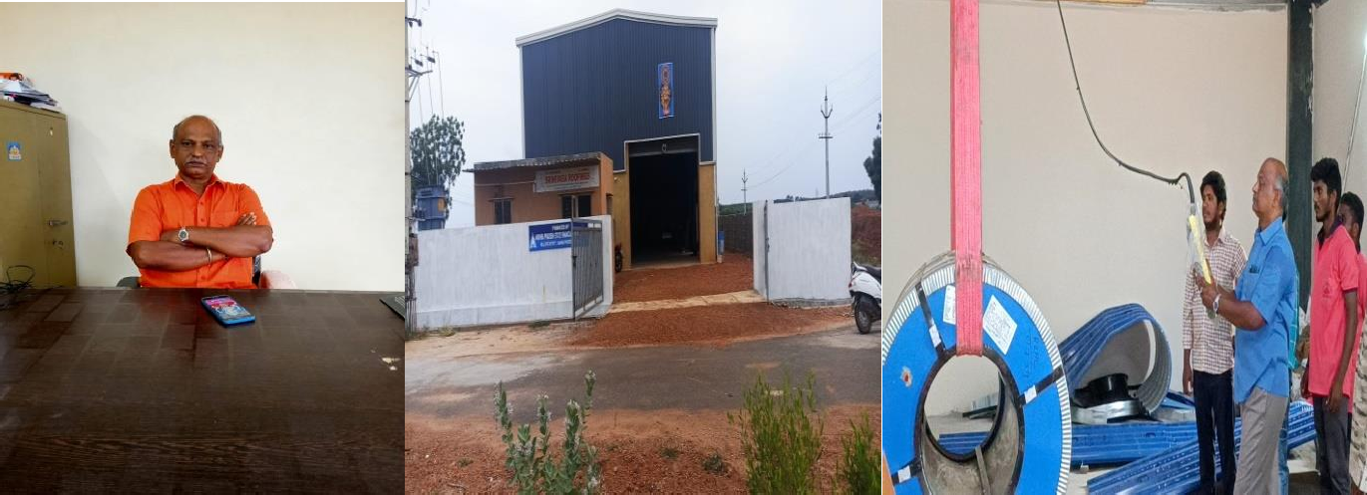
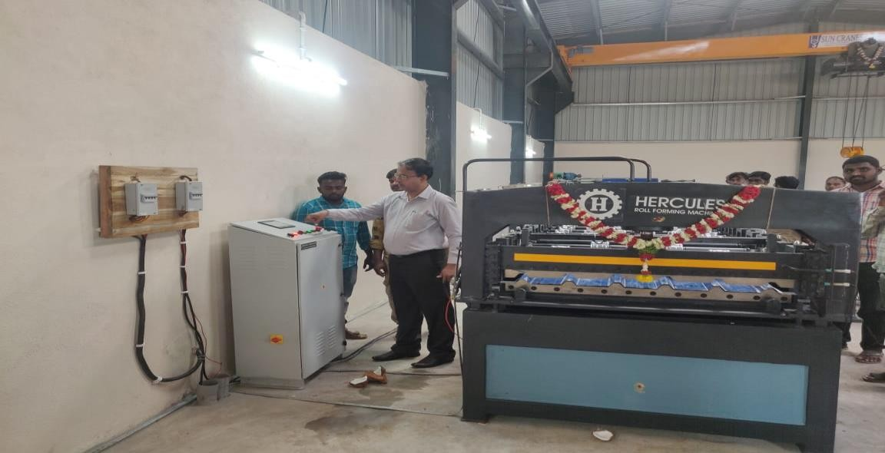
Andhra Pradesh State Financial Corporation {APSFC}, Vijayawada
M/s. Srinivasa Roofings
Shri Kolli Srinivasulu Reddy

Slide 9
Andhra Pradesh State Financial Corporation {APSFC}, Vijayawada
M/s. Srinivasa Roofings
Shri Kolli Srinivasulu Reddy established M/s. Srinivasa Roofings, with term loan of Rs 50.00 lakhs from APSFC to manufacture Colour Coated Galvalume Roofing Sheets (Fabrication) in SPSR Nellore District. The promoter commenced commercial operations satisfactorily and is being given the Best Entrepreneur award.

Slide 10
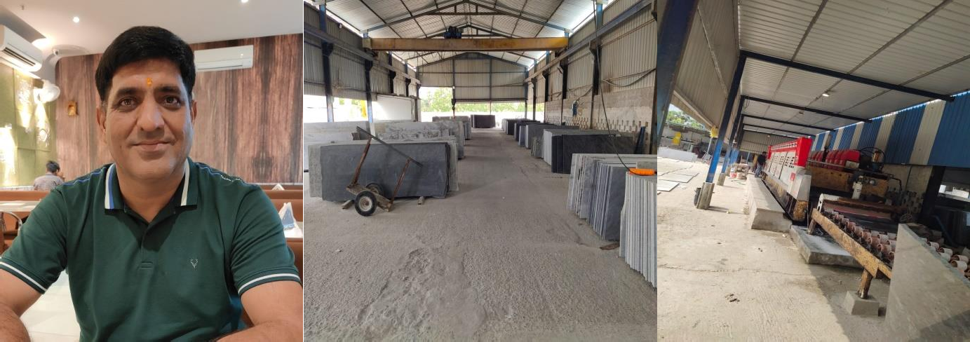
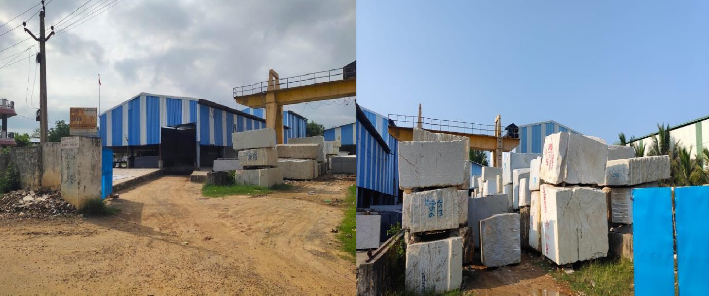
Andhra Pradesh State Financial Corporation {APSFC}, Vijayawada
M/s. JMB Rocks
Shri Sanjay Bagariya

Slide 11
Andhra Pradesh State Financial Corporation {APSFC}, Vijayawada
M/s. JMB Rocks
M/s. JMB Rocks established by Shri Sanjay Bagariya is engaged in granite cutting and polishing. The unit was established with term loan of Rs.100.00 lakhs in the year 2014 from APSFC to meet cost of Plant & Machinery under General Loan Scheme. The unit is working satisfactorily and earning net profits for the past 3 years. The firm is supplying their finished goods to Bengaluru, Mumbai, Kolkata, Kanyakumari, Hyderabad in India and they are also exporting their products to USA, Dubai, and Oman. Shri Sanjay Bagariya is being given the Best Entrepreneur Award.

Slide 12
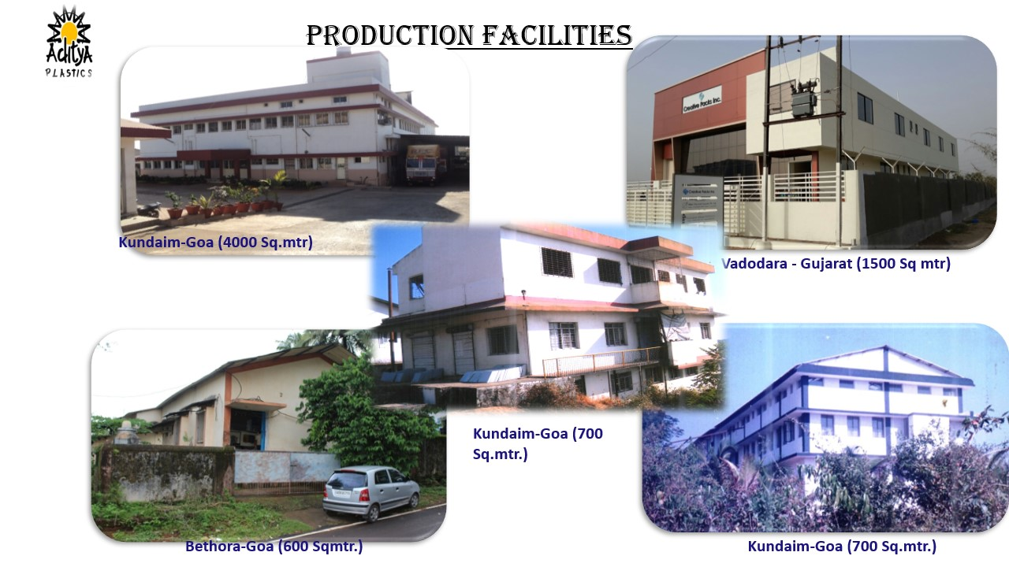
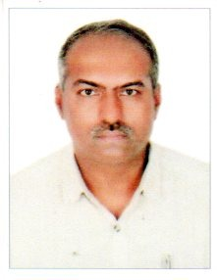
EDC Ltd. Panaji, Goa
M/s. Aditya Plastics
Shri Sandip Naik

Slide 13
EDC Ltd. Panaji, Goa
M/s. Aditya Plastics
M/s Aditya Plastics was founded by Shri Sandip Naik in the year 1993 to manufacture Injection / blow moulded containers, Caps, Measures and Bottles in Goa The unit has obtained CRISIL Rating certificate for Performance & Credit Rating in 2007. Shri Sandip Naik is being awarded as the “Best First Generation Entrepreneur”.

Slide 14
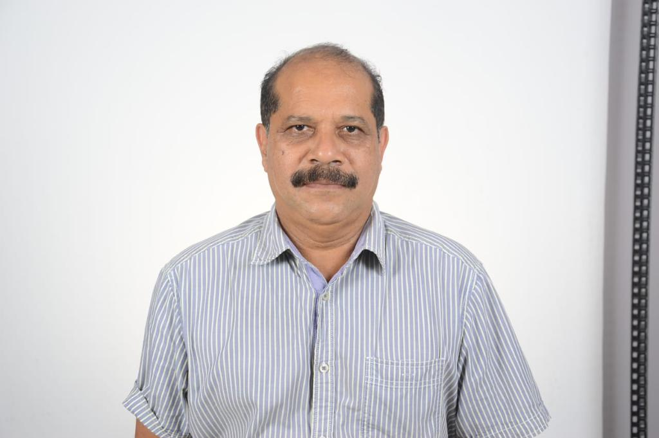
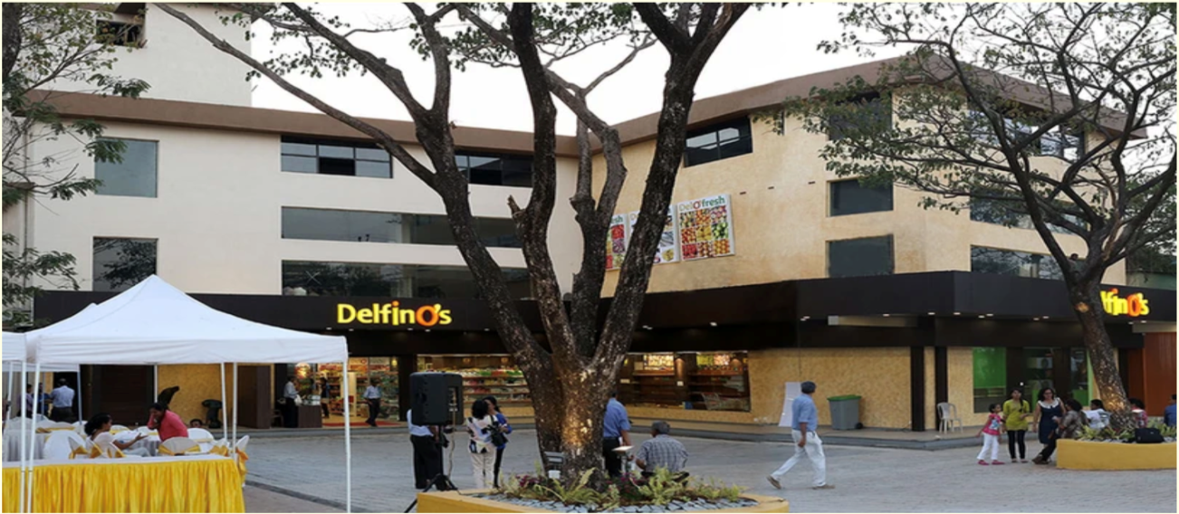

EDC Ltd. Panaji, Goa
M/s. Armacar Holdings Pvt. Ltd.
Shri. Prakash Pereira

Slide 15
EDC Ltd. Panaji, Goa
M/s. Armacar Holdings Pvt. Ltd.
M/s Armacar Holdings Pvt. Ltd. was established by Shri Prakash Pereira in the year 1994 with financial assistance from EDC Ltd. Goa. The Unit is a member of the Armacar Group of companies run by 6 brothers from Goa, the group operates within the retail and hospitality sectors in the state. Currently, the group’s retail ventures include supermarkets, sports stores, hardware stores, and tools stores. Within the hospitality sector, Armacar Holdings operates restaurants and hotels located in Goa. Shri Prakash Pereira is being conferred with the “Best Entrepreneur” award.

Slide 16
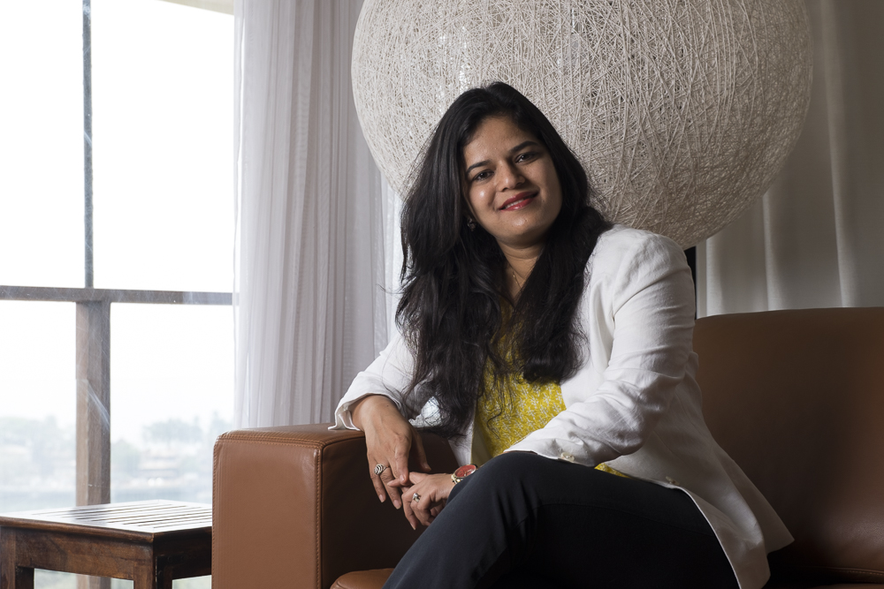
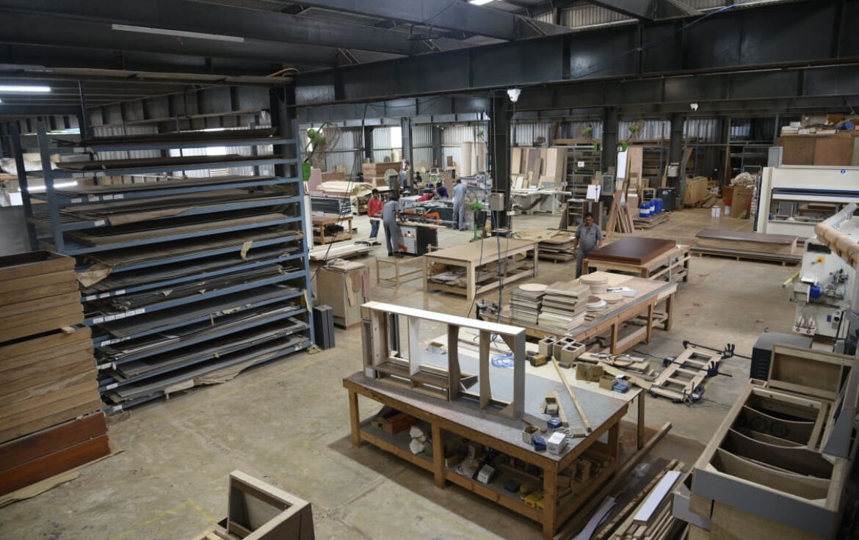
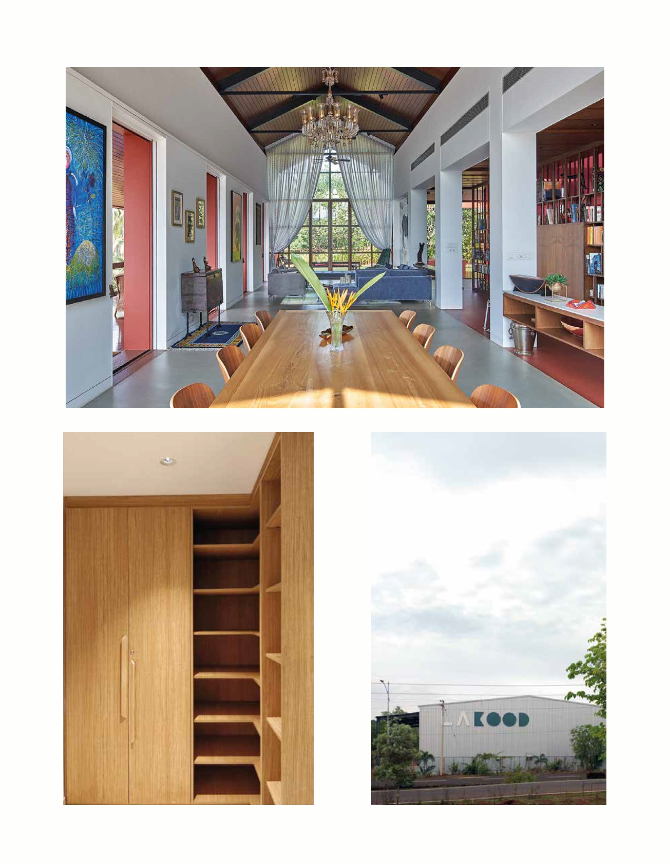
EDC Ltd. Panaji, Goa
M/s. La-Kood LLP
Smt. Reshma Sukhthankar

Slide 17
EDC Ltd. Panaji, Goa
M/s. La-Kood LLP
M/s La-Kood LLP was established by Smt. Reshma Sukhthankar with financial assistance of from EDC Ltd. Goa. The unit is State Of The Art manufacturing unit of wooden furniture, doors, consoles, kitchen etc.. Their work is sharp, crisp & tactile with focus on quality, details and durability. Smt. Reshma Sukhthankar has been given the “Best Woman Entrepreneur” Award.

Slide 18
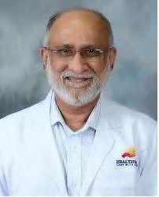
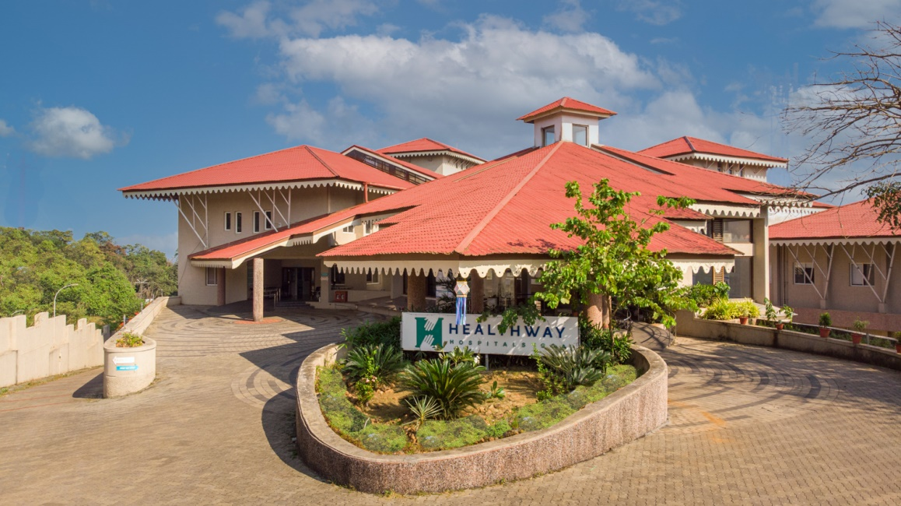
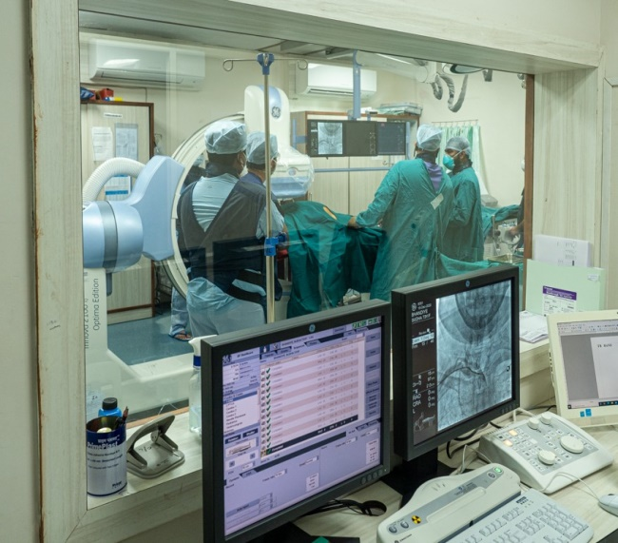
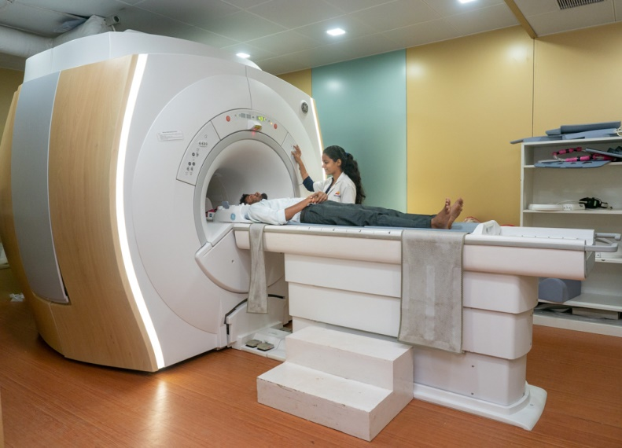
EDC Ltd. Panaji, Goa
M/s. Healthway Hospitals Pvt. Ltd.
Dr. Virendra Gaonkar, Chairman

Slide 19
EDC Ltd. Panaji, Goa
M/s. Healthway Hospitals Pvt. Ltd.
Dr. Virendra Gaonkar established M/s Healthway Hospitals Pvt. Ltd. with financial assistance from EDC Ltd. Goa. The hospital has the highest standards in healthcare with excellent patient outcomes. The unit has recently started its Education and Research wing with the launch of its Post Graduate DNB programme duly approved by The National Board of Examinations. To fulfill its academic objective, the hospital started its in-house ATLS (Advanced Trauma Life Support) teaching programme in 2016—the 9th centre in India to conduct the ATLS Course. ATLS is a course by the American College of Surgeons conducted in India under the auspices of the All India Institute of Medical Sciences (AIIMS). The hospital is accredited under NABH; NABL and NNF. The Promoter has been awarded the “Best Unit in Service Industries”.

Slide 20
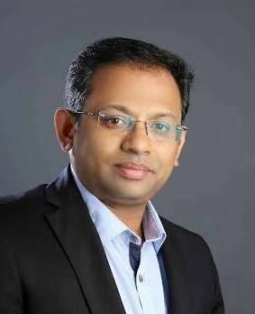
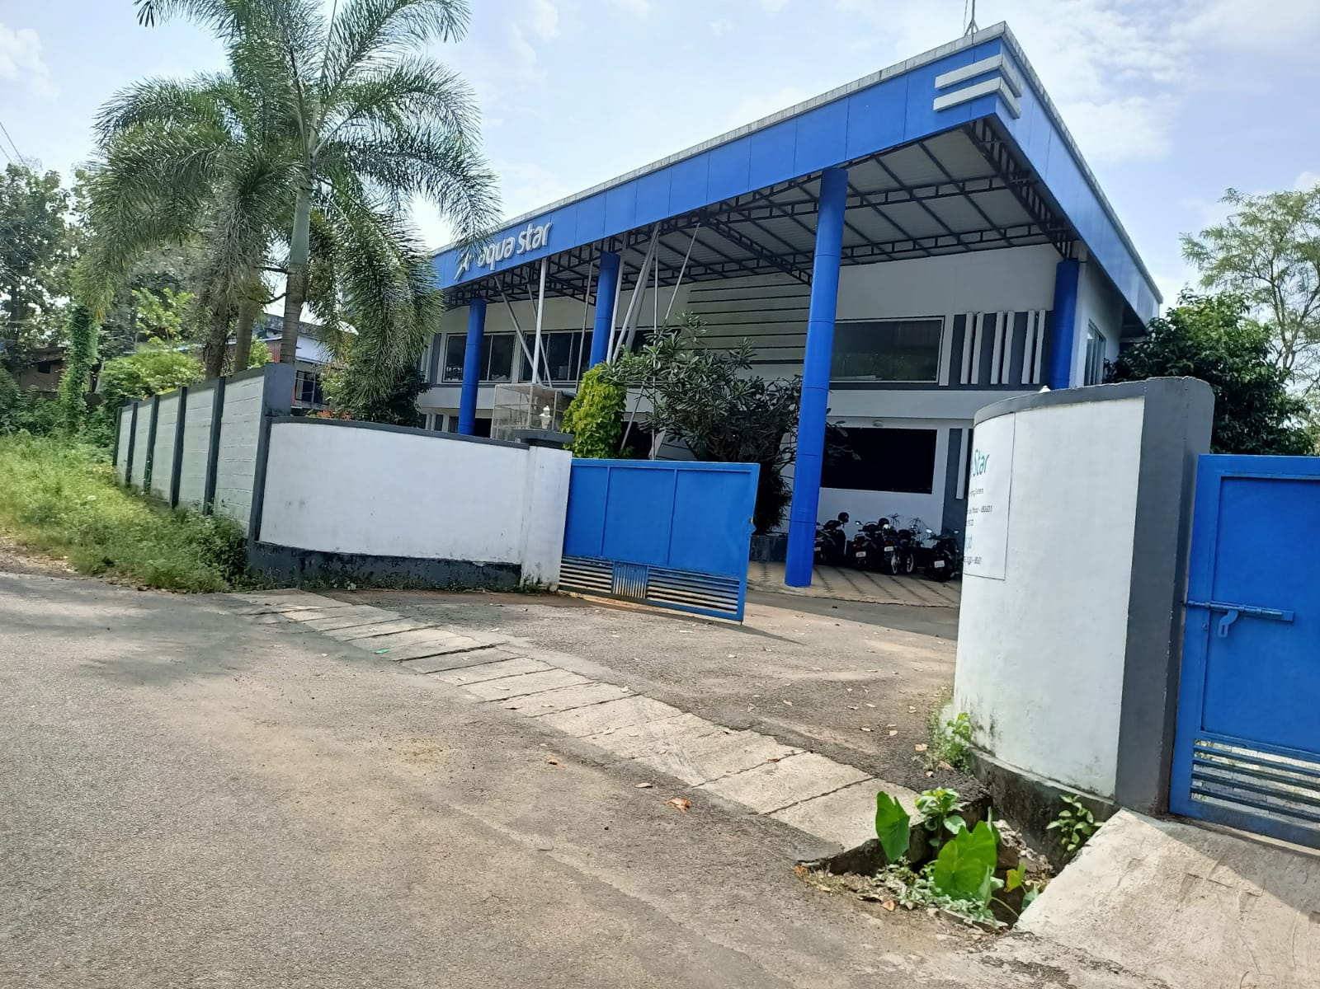
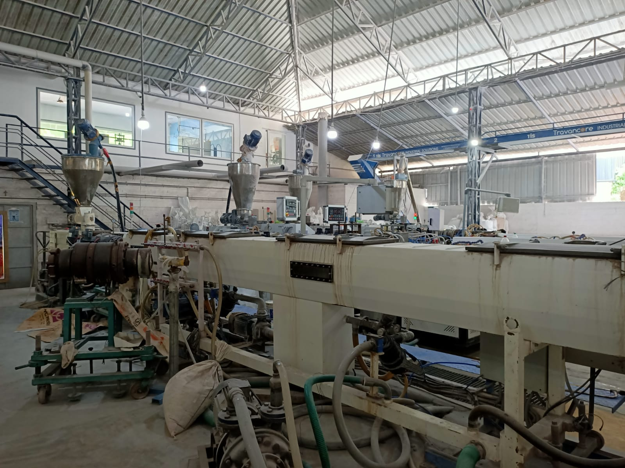
Kerala Financial Corporation (KFC), Thiruvananthapuram
M/s Aqua Star
Shri Seejo Ponnore Jose

Slide 21
Kerala Financial Corporation (KFC), Thiruvananthapuram
M/s Aqua Star
M/s Aqua Star was established by Shri Seejo Ponnore Jose in the year 2015 with financial assistance from KFC to design and manufacture India’s first corrugated & rectangle design uPVC rain gutters. “Aqua star” uPVC rainwater harvesting system (Rain gutters and fittings) is an innovative product which is patented, developed and manufactured for domestic and commercial purpose. The company’s competitive edge lies in its R&D activities and is ISO 9001:2015 certified.

Slide 22
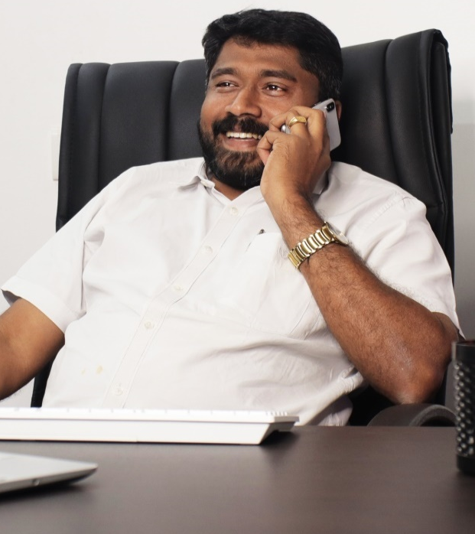
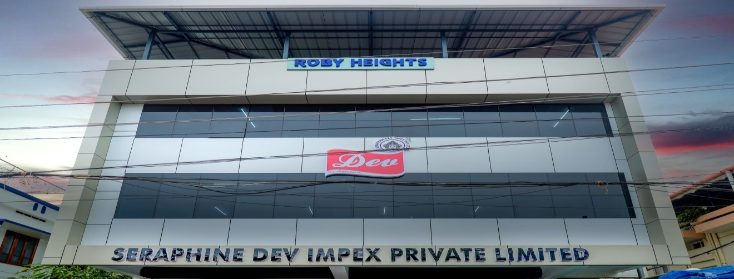
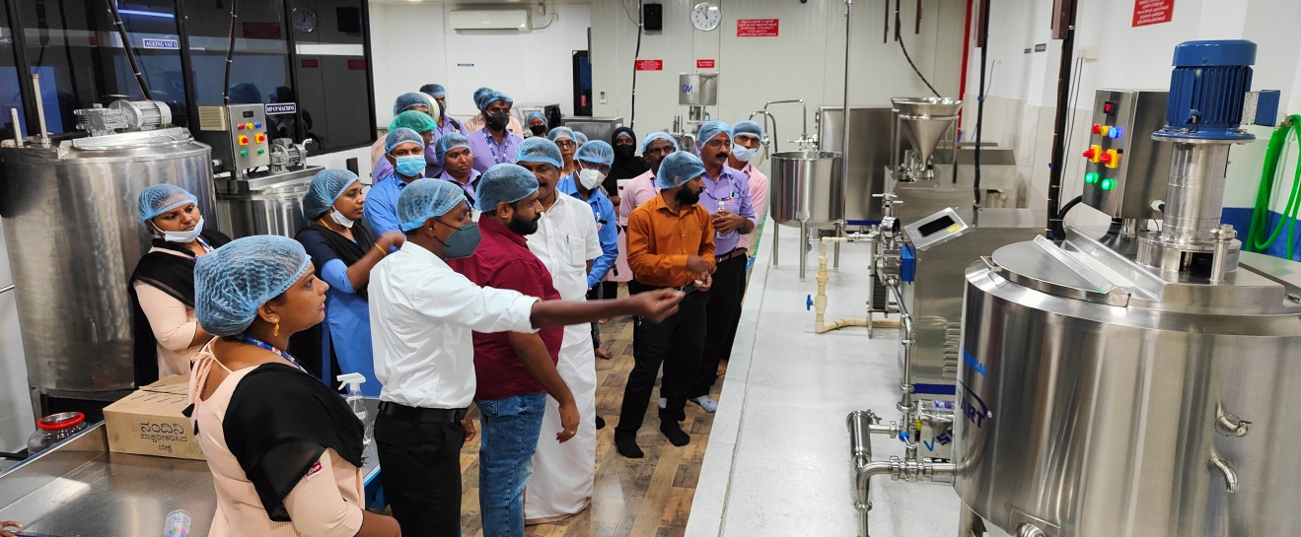
Kerala Financial Corporation (KFC), Thiruvananthapuram
M/s Dev Snacks
Shri Ronak R

Slide 23
Kerala Financial Corporation (KFC), Thiruvananthapuram
M/s Dev Snacks
M/s Dev Snacks was established by Shri Ronak R in the year 1990 with financial assistance from KFC. The unit makes a wide variety of snacks under different brands such as Dev, Eva, Dev ice cream etc. Its major partners are Reliance India Limited, More Retails Pvt Ltd, Future Retail Ltd., Lulu Hyper Mart, Spencer Retail Ltd, Sylcon Hyper Market, and Trent Hyper Market etc. The unit is also supplying to government departmental co-operative stores like Indian Rare Earths, Kerala Minerals & Metals Ltd, Bharat Petroleum Corporation; subsidiary Central Canteen of Kerala Police etc. The company created its goodwill without any advertising strategies. Its high quality products are supplied to different shops through the company's own distribution channel. The company is in the process of setting up a new automated plant.

Slide 24
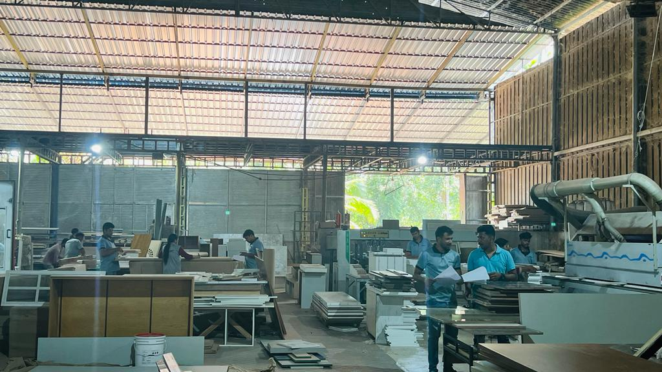
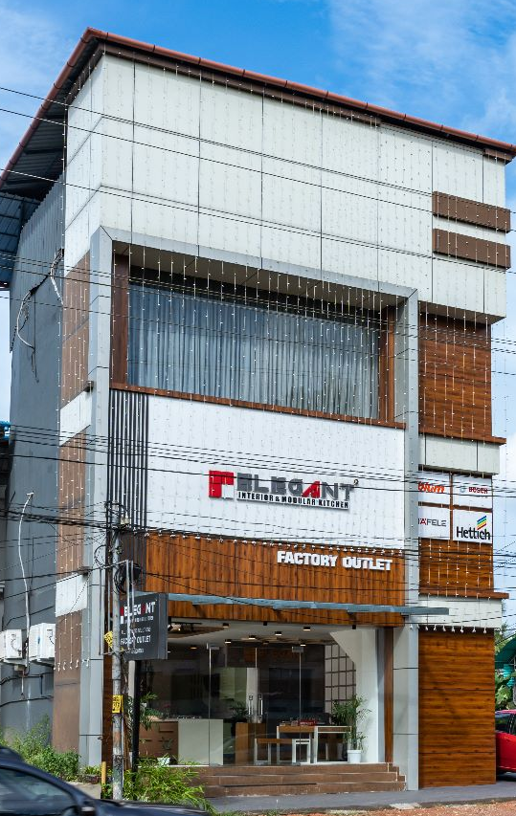
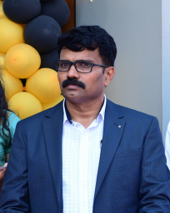
Kerala Financial Corporation (KFC), Thiruvananthapuram
M/s Elegant Interior & Modular Kitchen
Shri Ranjith K

Slide 25
Kerala Financial Corporation (KFC), Thiruvananthapuram
M/s Elegant Interior & Modular Kitchen
Shri Ranjith K established M/s Elegant Interior & Modular Kitchen in the year 2008 with financial assistance from KFC. The company started working with 2 employees and now employs 80 people. It has production units as well as six showrooms and is a leading supplier of modular kitchens.

Slide 26
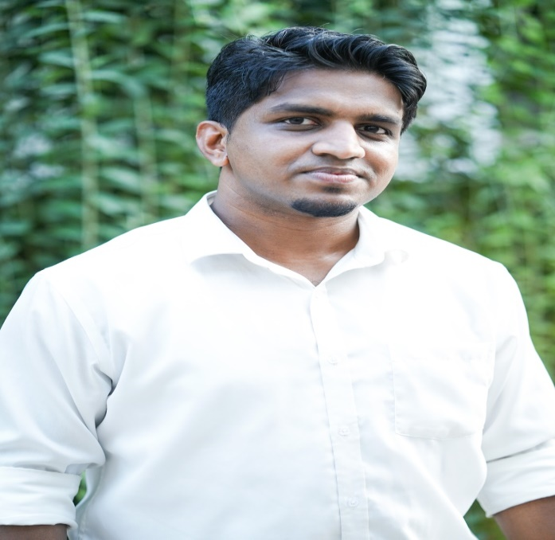
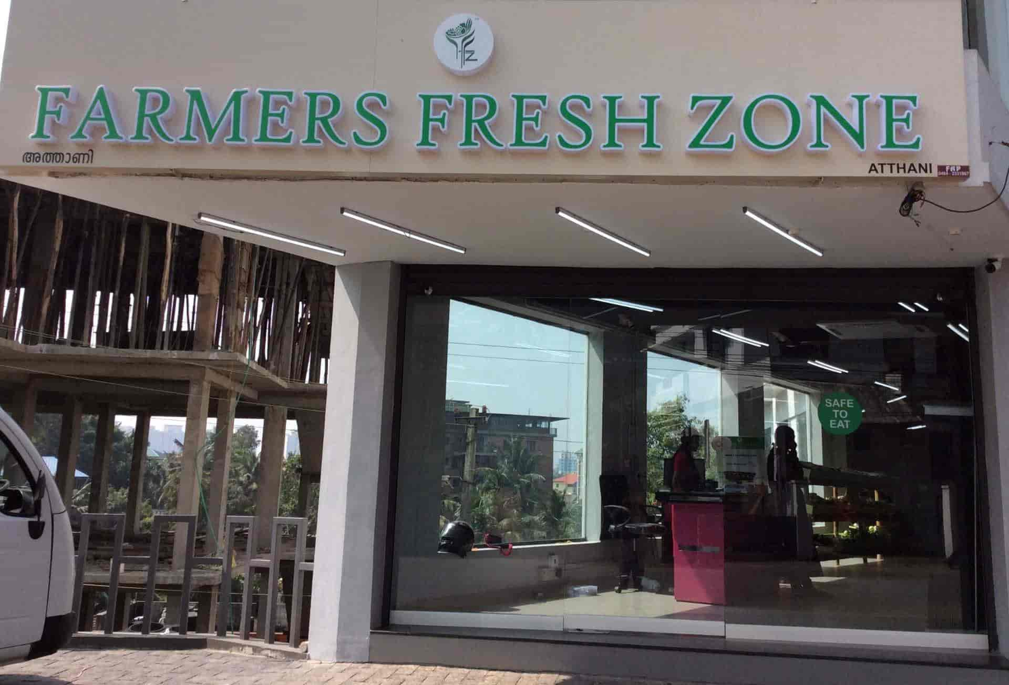
Kerala Financial Corporation (KFC), Thiruvananthapuram
M/s Farmers Fresh
Shri Pradeep P S

Slide 27
Kerala Financial Corporation (KFC), Thiruvananthapuram
M/s Farmers Fresh
M/s Farmers Fresh was established by Shri Pradeep P S in the year 2016 with financial assistance from KFC. The unit is an agri tech, purely B2C-focused farm-to-fork supply chain offering fresh, safe-to-eat pesticide free fruits and vegetables to consumers. The unit employs more than 200 people and has impacted more than 2000 farming families by increasing their income by 15%. Fruit & Vegetable industries major problem is wastage, more than 25% of the production is wasted in different phases but in Farmers Fresh production to supply chain it was brought down below 5%. The unit provides one-stop solution for fruits and vegetable requirement vie e-commerce module with traceability. It serves more than 1lakh customers across 5 cities and was able to achieve 15x times growth in all aspects. The unit plans to connect 20000 more farmers by the end of 2023. Shri Pradeep PS, a software engineer turned entrepreneur, is very passionate about agriculture and aims to improve the health and wellness standards of consumers.

Slide 28
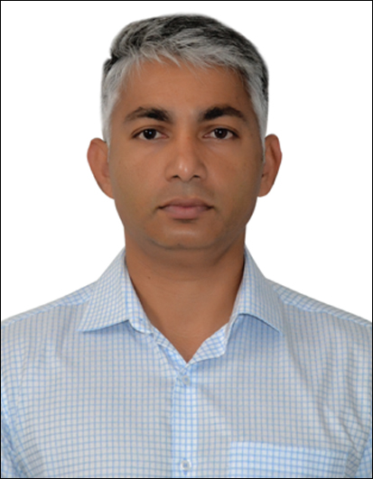
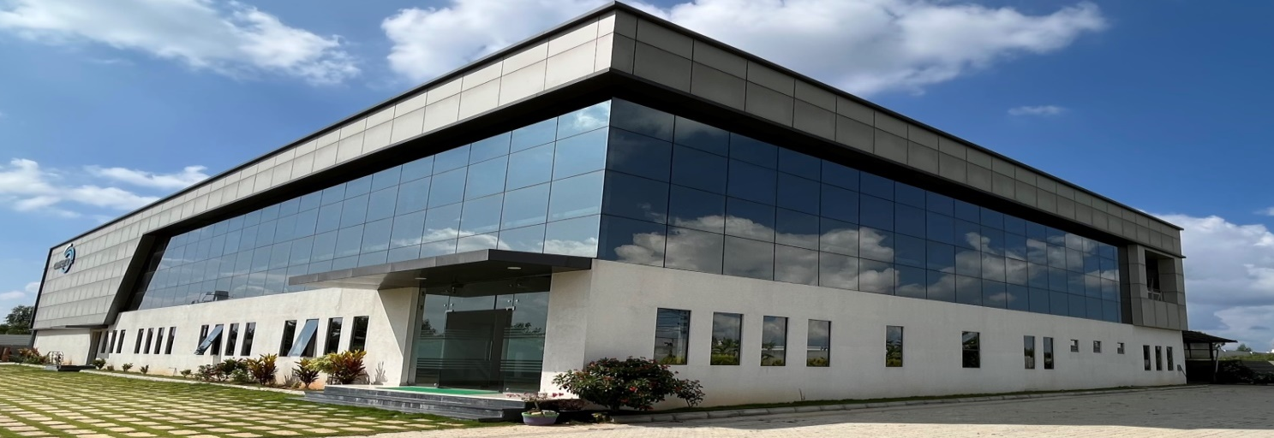
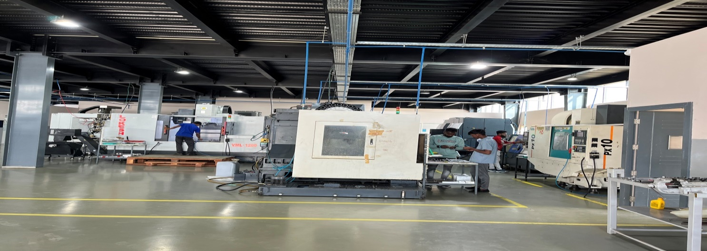
Karnataka State Financial Corporation {KSFC}, Bengaluru
M/s. Cohera Automation Pvt. Ltd
Shri Deepu T. John

Slide 29
Karnataka State Financial Corporation {KSFC}, Bengaluru
M/s. Cohera Automation Pvt. Ltd
Shri Deepu T. John established M/s Cohera Automation Pvt. Ltd. with financial assistance of Rs.65 lakhs from KSFC in the year 2019. The unit is manufacturing Aerospace parts using precision components/Steel and exporting its products to Malysia, Europe and US. It employs 35 people and achieved a turnover of Rs.445.54 lakhs in the year 2021-22. Shri Deepu T. John is being conferred with the Best Entrepreneur award.

Slide 30
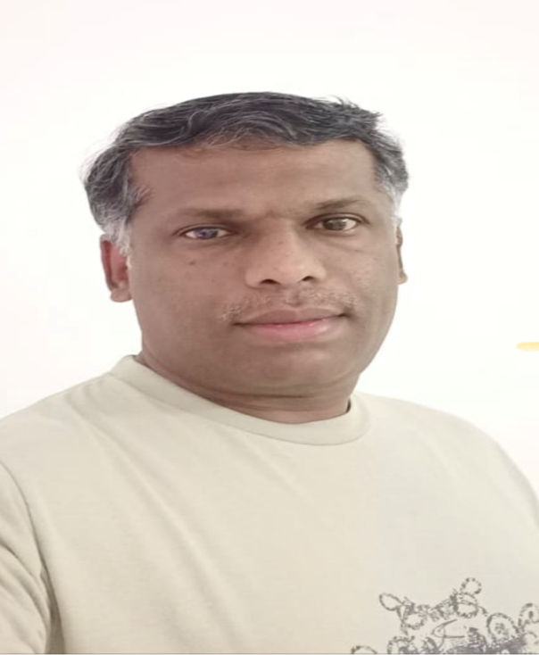
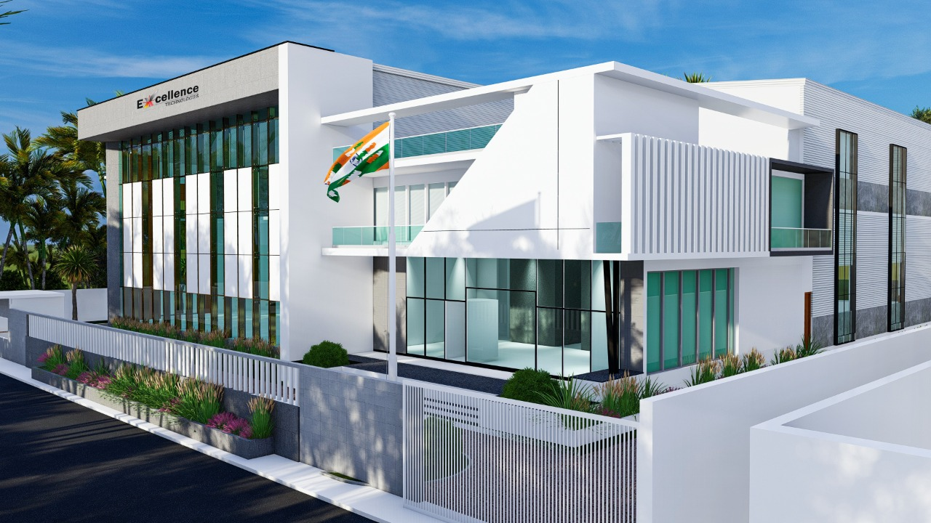
Karnataka State Financial Corporation {KSFC}, Bengaluru
M/s. Excellent Technologies
Shri Sunil Kumar C

Slide 31
Karnataka State Financial Corporation {KSFC}, Bengaluru
M/s. Excellent Technologies
Shri Sunil Kumar C established M/s Excellent Technologies in the year 2015. He received financial assistance of Rs. 830 lakhs over the years from KSFC. The unit manufacturers Machine tools accessories for automotive and Aero space sector and exports 75% of its products to Germany, Italy, UK, USA, Australia. The unit employs 40 people and achieved a turnover Rs.1200 lakhs in the year 2021-22. Shri Sunil Kumar C is being awarded as the ‘Best Entrepreneur’.

Slide 32
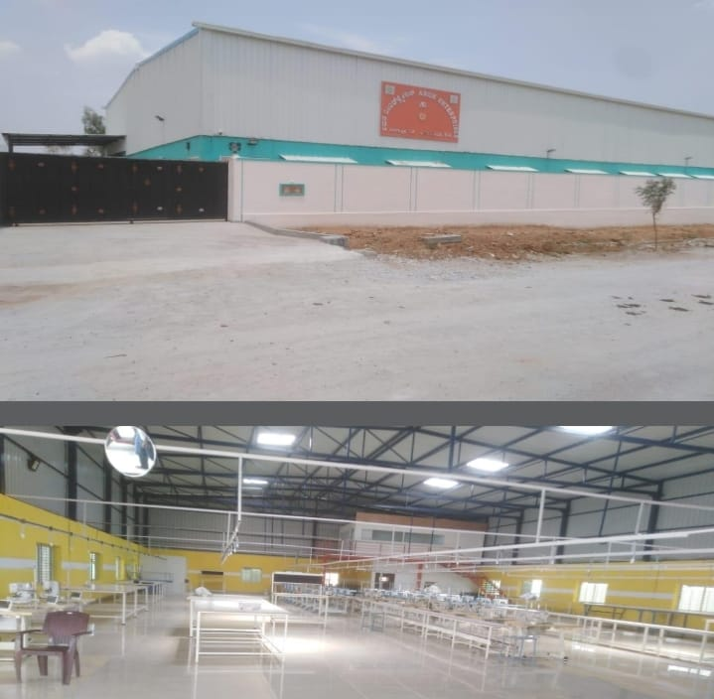
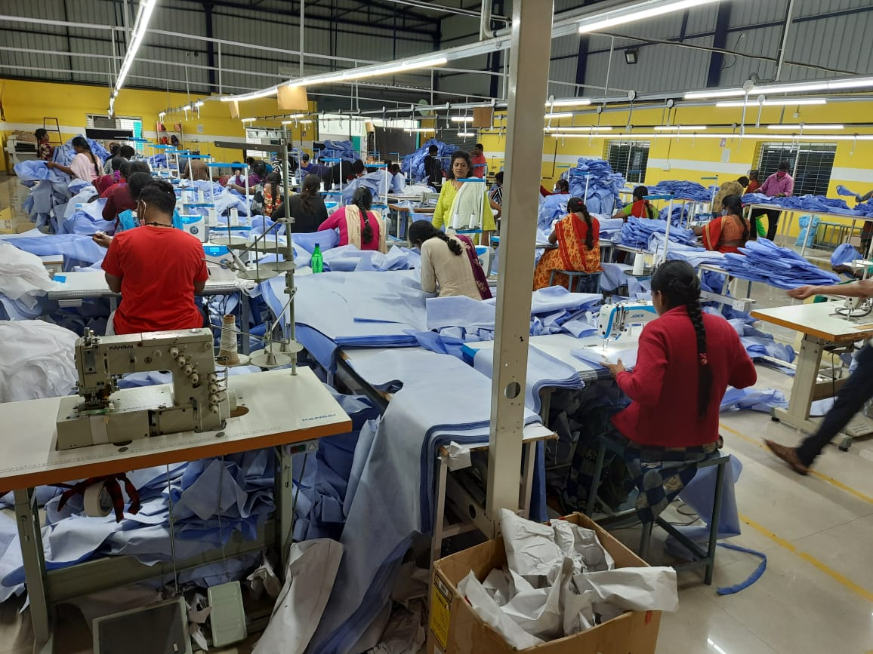
Karnataka State Financial Corporation {KSFC}, Bengaluru
M/s. Arun Enterprises

Slide 33
Karnataka State Financial Corporation {KSFC}, Bengaluru
M/s. Arun Enterprises
Shri Arun Nayaka N K established M/s Arun Enterprises with financial assistance of Rs. 90 lakhs from KSFC in the year 2017 under 4% interest subvention scheme of Government of Karnataka for SC/ST entrepreneurs. The unit manufactures cotton fabric readymade garments for children. The company is supplying to Scotch garments, Raymond Garments and Bombay Dyeing. The unit employs 40 people and achieved a turnover of Rs.123 lakhs in the year 2021-22. The promoter is being awarded the ‘Best First Generation Entrepreneur’.

Slide 34
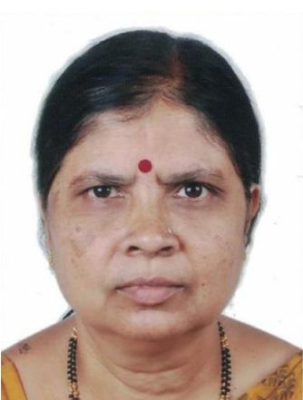
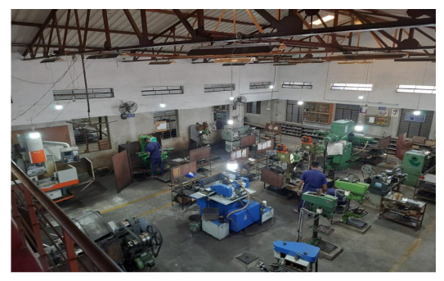
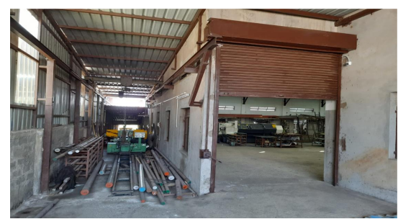
Karnataka State Financial Corporation {KSFC}, Bengaluru
M/s. Jain Seals
Smt. Asha Ashok Dhanawade

Slide 35
Karnataka State Financial Corporation {KSFC}, Bengaluru
M/s. Jain Seals
M/s Jain Seals was established by Smt. Asha Ashok Dhanawade with financial assistance of Rs.22 lakhs from KSFC in the year 2019 under 4% interest subsidy scheme for women entrepreneurs. The unit manufactures mechanical seals, CNC machine spares and pumps and distillery spares bearing isolators, etc. for engineering and agricultural activity. It employs 16 people and achieved a turnover of Rs.96.12 lakhs in the year 2021-22. Smt. Asha Ashok Dhanawade is being awarded the ‘Best Woman Entrepreneur’.

Slide 36
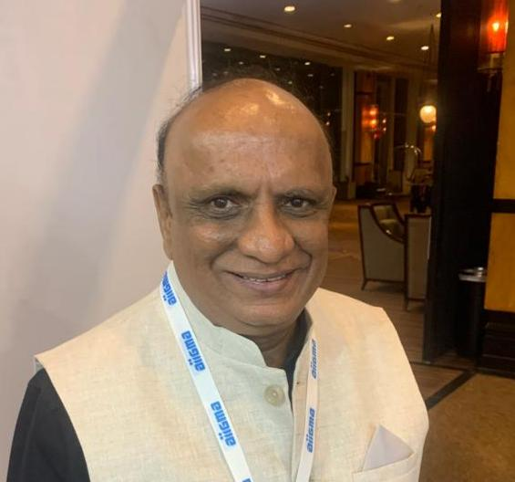
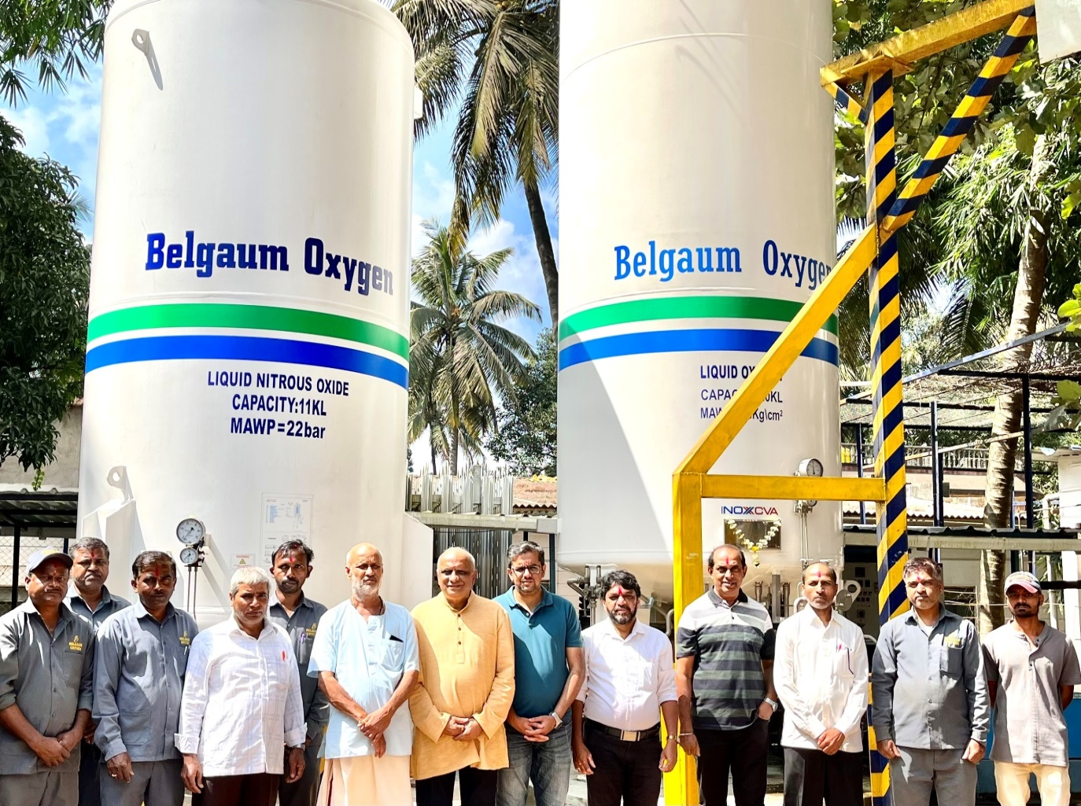
Karnataka State Financial Corporation {KSFC}, Bengaluru
M/s. Belgaum Oxygen Pvt. Ltd
Shri Venkatesh K. Patil

Slide 37
Karnataka State Financial Corporation {KSFC}, Bengaluru
M/s. Belgaum Oxygen Pvt. Ltd
Shri Venkatesh K. Patil established M/s Belgaum Oxygen Pvt. Ltd. for manufacturing medical oxygen/gas with financial assistance of Rs.425 lakhs from KSFC under 5.5% interest subsidy scheme for MSMEs Sector. During COVID-19, the company supplied Medical Oxygen to all the hospitals. More than 8000 medical cylinders were supplied free of cost. It employs 22 people and had a turnover of Rs.7.58 crores in the year 2021-22. The Promoter has been awarded the ‘Best Service Entrepreneur’.

Slide 38
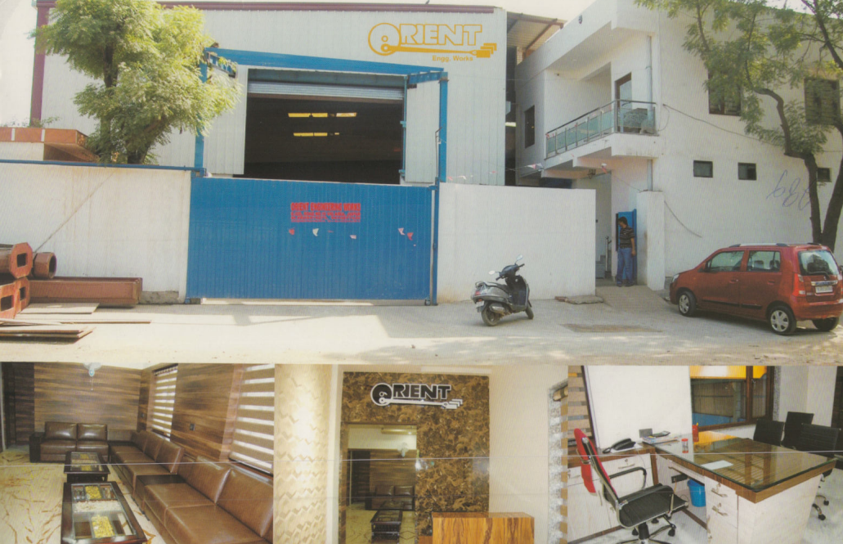
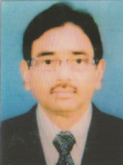
Rajasthan Financial Corporation {RFC}, Jaipur
M/s. Orient Engineering Works
Shri Dayal Kumar

Slide 39
Rajasthan Financial Corporation {RFC}, Jaipur
M/s. Orient Engineering Works
M/s Orient Engineering works was established by Shri Dayal Kumar with financial assistance from RFC to manufacture Marble & Granite slabs and tiles; Sandstone Marble & Granite cutting & polishing machines. Shri Dayal Kumar expanded the unit in 2020 and set up a modern fully automatic plant. The unit achieved turnover of Rs.4.33 crore in the year 2021-22. Shri Dayal Kumar is being awarded as the "Best Entrepreneur".

Slide 40
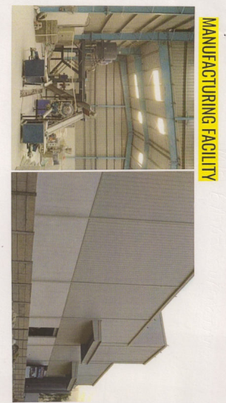
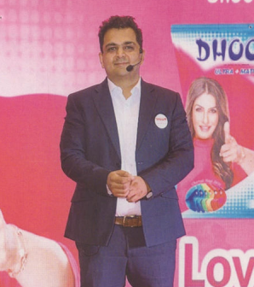
Rajasthan Financial Corporation {RFC}, Jaipur
M/s Bajaj Surfactants
Shri Anshul Bajaj

Slide 41
Rajasthan Financial Corporation {RFC}, Jaipur
M/s Bajaj Surfactants
M/s Bajaj Surfactants was established by Shri Saurabh Bajaj and Shri Anshul Bajaj with financial assistance of Rs.170 lakhs under the scheme Yuva Udyamita Protsahan Yojana (YUPY) and Rs.20 lakhs under GTL scheme in the year 2018 from RFC. The unit manufactures detergent powder, detergent cake, dishwash Bar, Liquid dishwash and toilet cleaner and has a turnover of Rs.276.33 lakh. Shri Saurabh Bajaj and Shri Anshul Bajaj are being conferred the "Best Entrepreneur" award.

Slide 42


Rajasthan Financial Corporation {RFC}, Jaipur
M/s Suryanagri Synthetics
Shri Anil Kothari

Slide 43
Rajasthan Financial Corporation {RFC}, Jaipur
M/s Suryanagri Synthetics
Shri Anil Kothari established M/s Suryanagari Synthetics with financial assistance of Rs.190 lakh from RFC in the year 2000 under the GTL scheme to manufacture Laundry soap. The promoter is self made entrepreneur and is being given the award of the Best Entrepreneur.

Slide 44


Rajasthan Financial Corporation {RFC}, Jaipur
M/s Quality Chemical & Minerals
Shri Manish Gupta

Slide 45
Rajasthan Financial Corporation {RFC}, Jaipur
M/s Quality Chemical & Minerals
M/s Quality Chemical & Minerals was established by Shri Manish Gupta with financial assistance of Rs.24.40 lakhs from RFC in the year 2017 to manufacture Hydated Lime. The unit employs 200-300 labourers directly or indirectly. Shri Manish Gupta is being given the Best Entrepreneur Award.

Slide 46

Rajasthan Financial Corporation {RFC}, Jaipur
M/s Indo Toyo Tronix Pvt. Ltd.
Shri Abhishek Sharma

Slide 47
Rajasthan Financial Corporation {RFC}, Jaipur
M/s Indo Toyo Tronix Pvt. Ltd.
M/s Indo Toyo Tronix Pvt. Ltd. was established by Shri Abhishek Sharma with financial assistance of Rs.100 lakh from RFC under its Saral Loan Scheme to manufacture Handicrafts and Chemicals. The unit employs 300-400 labourers directly or indirectly. Shri Abhishek Sharma is being given the Best Entrepreneur Award.

Slide 48


Rajasthan Financial Corporation {RFC}, Jaipur
M/s Hari Om Art & Craft Inc
Smt. Chandrakanta Sharma

Slide 49
Rajasthan Financial Corporation {RFC}, Jaipur
M/s Hari Om Art & Craft Inc
M/s Hari Om Art & Craft Inc was established by Smt. Chandrakanta Sharma in the year 2016 with loan of Rs. 150 lakhs from RFC under its YUPY scheme. A top up loan of Rs. 107 lakhs was also granted in the year 2022. The unit manufactures wooden handicrafts and has employed 200-300 labourers directly or indirectly. Smt. Chandrakanta Sharma is being awarded as the “Best Entrepreneur”.

Slide 50


Rajasthan Financial Corporation {RFC}, Jaipur
M/s Modern Marwar Corporation
Shri Dilip Singh

Slide 51
Rajasthan Financial Corporation {RFC}, Jaipur
M/s Modern Marwar Corporation
Shri Dilip Singh established M/s Modern Mewar Corporation with loan of Rs. 125 lakhs under Yuva Udyamita Protsahan Yojana (YUPY) scheme of RFC in the year 2018. The unit manufactures readymade garments and handicraft items and has employed 150-200 labourers directly or indirectly. Shri Dilip Singh is being given the “Best Entrepreneur Award”.

Slide 52



Rajasthan Financial Corporation {RFC}, Jaipur
M/s Voila Inc.
Cutting Machine
Sewing Machine
Smt. Varsha Joshi

Slide 53
Rajasthan Financial Corporation {RFC}, Jaipur
M/s Voila Inc.
M/s Voila Inc was established by Smt. Varsha Joshi in the year 2014 with loan assistance of Rs. 100 lakhs under Yuva Udyamita Protsahan Yojana (YUPY) scheme of RFC to manufacture Garments & Made Ups. Smt. Varsha Joshi has been given the “Best Woman Entrepreneur” Award.

Slide 54



Rajasthan Financial Corporation {RFC}, Jaipur
M/s B M Instruments
Smt. Sharda Bhadu

Slide 55
Rajasthan Financial Corporation {RFC}, Jaipur
M/s B M Instruments
Smt. Sharda Bhadu established M/s B. M. Instruments in the year 2014 to manufacture electronic weighing scales and printed circuits with loans assistance of Rs. 90 lakhs under Yuva Udyamita Protsahan Yojana (YUPY) scheme of RFC. The promoter is a technocrat and is being awarded as the “Best Entrepreneur”.

Slide 56
Jammu & Kashmir and Ladakh Finance Corp. {JKLFC}, Jammu
M/s Choice Ice-Cream & Bakery
M/s Choice Ice Cream and Bakery was established by Shri S. Ranjeet Singh in rural area of Kattua with financial assistance of Rs.5 lakhs under the NMDFC Scheme of JKLFC. The promoter is a first generation entrepreneur and caters to the demand of local people to supply Bread, Bakery products and Ice Creams. The unit also employs 8-10 people.

Slide 57
Jammu & Kashmir and Ladakh Finance Corp. {JKLFC}, Jammu
M/s Hardeep Boutique
M/s Hardeep Boutique was established by Smt. Hardeep Kour with financial assistance of Rs. 3 lakhs from JKLFC under its NMDFC Scheme. The promoter is specially abled. Her boutique caters to local demand in the rural area of Rajbagh, Kathua. She also imparts training to young unemployed females of the area.

Slide 58
Jammu & Kashmir and Ladakh Finance Corp. {JKLFC}, Jammu
M/s Nazma Dairy Farm
M/s Nazma Dairy Farm was established by Smt. Nazma Bibi with financial assistance of Rs.5 lakhs from JKLFC under the scheme NMDFC. The promoter is a first generation entrepreneur and provides milk and milk products to local people in the rural area of Jammu. The unit also employs 4-5 people.

Slide 59
Jammu & Kashmir and Ladakh Finance Corp. {JKLFC}, Jammu
M/s Micron Clinical Laboratory (General)
M/s Micron Clinical Laboratory was established by Shri Muneer Ahmed with financial assistance of Rs. 5 lakhs under the scheme NMDFC from JKLFC. The unit is a pathology laboratory with modern equipment and latest technology. The promoter is a technical expert with diploma in pathology. The unit also employs 3-4 people.

Slide 60
Jammu & Kashmir and Ladakh Finance Corp. {JKLFC}, Jammu
M/s Atulaya Medical Shop (Natural Herbs)
Shri S. Sarabjit Singh is a first generation entrepreneur. He established M/s Atulya Medical Shop with financial assistance of Rs.5 lakh under NMDFC scheme of JKLFC. The unit is an Ayurvedic medicine shop in rural area at Ranjitpura, Jammu.

Slide 61



Tamilnadu Industrial Investment Corp. Ltd. {TIIC}, Chennai
M/s Suri Graphix
Shri A.I. Thirumalaikumaran

Slide 62
Tamilnadu Industrial Investment Corp. Ltd. {TIIC}, Chennai
M/s Suri Graphix
M/s Suri Graphix was established in the year 2012 by Shri A.I. Thirumalaikumaran with financial assistance from TIIC. The unit is manufacturing Paper Boards and Paper Boxes for packing food items. These boxes are used as alternative products to one time use and throw away plastics. The promoter is being conferred with the Best Entrepreneur award.

Slide 63


Tamilnadu Industrial Investment Corp. Ltd. {TIIC}, Chennai
M/s Subavalli Tamilmathi Hospital

Slide 64
Tamilnadu Industrial Investment Corp. Ltd. {TIIC}, Chennai
M/s Subavalli Tamilmathi Hospital
Subavalli Tamilmathi hospital was established by Dr. S. Santosh in the year 2019 with financial assistance from TIIC. The hospital provides consultants in the field of Cardiology, Nephrology, Neurosurgery, Oncosurgery and Orthopedic. It employs 35 people and offers OP Service (Out Patient); IP Service (Out Patient; ICU; Neonatal Care and Surgery.

Slide 65


Tamilnadu Industrial Investment Corp. Ltd. {TIIC}, Chennai
M/s Vishwas Paper Boards
Shri R. Vijayakumar

Slide 66
Tamilnadu Industrial Investment Corp. Ltd. {TIIC}, Chennai
M/s Vishwas Paper Boards
Shri A. K. Vishwanathan and Shri R. Vijayakumar established M/s Vishwas Paper Boards with financial assistance from TIIC in the year 2012. The unit manufactures 30MT of Kraft paper and Kraft paper board per day. The unit is using only backwater by recycling it and maintaining zero discharge. Shri R. Vijayakumar is being awarded as the Best Entrepreneur.

Slide 67



Tamilnadu Industrial Investment Corp. Ltd. {TIIC}, Chennai
M/s. Knitvel Needles Private Limited
Shri L.K.M. Adhi

Slide 68
Tamilnadu Industrial Investment Corp. Ltd. {TIIC}, Chennai
M/s. Knitvel Needles Private Limited
M/s. Knitvel Needles Private Limited was established by Shri L.K.M. Adhi in the year 1979 with financial assistance from TIIC to manufacture precisely designed hosiery needles for the circular and flatbed Hosiery machinery requirements. The company has diversified into Sheet metal and Tubular fabricated parts catering to OEM’s like Ashok Leyland, TVS Motor Company, Tafe Tractors, etc. The company is recognized for its contribution towards the social upliftment of Hosur Township through financial contribution and by other means for School Education, Environment friendly activities, etc. The unit has obtained ISO 9001:2015 and is in the process of adding on ISO –TS16949 certification. Shri L.K.M. Adhi is being conferred with the “Best Entrepreneur” award.

Slide 69



Tamilnadu Industrial Investment Corp. Ltd. {TIIC}, Chennai
M/s Kalpaka Chemicals Pvt. Ltd.

Slide 70
Tamilnadu Industrial Investment Corp. Ltd. {TIIC}, Chennai
M/s Kalpaka Chemicals Pvt. Ltd.
Shri S. Ganesan established M/s Kalpaka Chemicals Pvt. Ltd. in the year 1998 with financial assistance from TIIC to manufacture steam activated carbon from coconut shell, Charcoal (agro waste). The unit exports its products to 17 countries. The products are used for Water Treatment, Air purification, Effluent Treatment, Syrup Solution and Gold Recovery etc. The unit has obtained ISO 9001:2015; ISO 14000:2015; ISO 45001:2018; NSF and HALAL certification and has been awarded the Best Exporting unit.

Slide 71



Tamilnadu Industrial Investment Corp. Ltd. {TIIC}, Chennai
M/s Raini Industries India Pvt. Ltd.
Shri L. Rathnaraj

Slide 72
Tamilnadu Industrial Investment Corp. Ltd. {TIIC}, Chennai
M/s Raini Industries India Pvt. Ltd.
M/s Raini Industries India Pvt. Ltd. was established by Shri L. Rathnaraj with financial assistance from TIIC in the year 2007 to manufacture Moulds, Plastic and sheet metal components. The unit exports to France, Brazil, Japan, Italy, UK, China and Switzerland. The firm has obtained ISO 9001:2015; ISO 14001:2015; ISO 45001:2018 and IATF 16949:2016 certification. Shri L Rathnaraj is being awarded as the Best First Generation Entrepreneur.

Slide 73



Rajasthan State Industrial Development & Investment Corp. Ltd. {RIICO}, Jaipur
M/s Shree Ram India Gums Ltd.
Shri Mahesh Soni
Shri Chirayu Soni

Slide 74
Rajasthan State Industrial Development & Investment Corp. Ltd. {RIICO}, Jaipur
M/s Shree Ram India Gums Ltd.
Shri Mahesh Soni and Shri Chirayu Soni established M/s Shree Ram India Gums Ltd. in the year 2006 with financial assistance from RIICO and is a pioneer in the guar industry. The unit manufactures and exports guar gum powder and guar meal. The promoters believe in continuous product development through rigorous research and as a result were able to produce high protein guar to cater to various sectors. M/s Shree Ram India Gums Ltd. have commissioned a new plant for commercial production in 2022. Total project cost is Rs.23 crores and the production capacity is 2500 mt per month.

Slide 75


Rajasthan State Industrial Development & Investment Corp. Ltd. {RIICO}, Jaipur
M/s Jagshanti Mineral Griding Mills
Shri Divyesh Parihar

Slide 76
Rajasthan State Industrial Development & Investment Corp. Ltd. {RIICO}, Jaipur
M/s Jagshanti Mineral Griding Mills
M/s Jagshanti Mineral Grinding Mills established its first mineral processing unit in 1978 in Jodhpur and manufactures products like Bentonite Powder; China Clay Powder; Limestone Powder; Hydrated Lime Powder; Laterite Powder; Garlic Powder and Flakes and Onion Powder and flakes. The firm now has 5 units of mineral processing with total installed capacity of 300 – 350 Metric Tonnes per day. In-house laboratory facility for quality control and quality consistency & two layered checking of product is done. The unit has been conferred with Best MSME Award and has obtained ISO certification 9001:2008 and is certified as a part of Dun & Bradstreet Global data base. Shri Divyesh Parihar is Director of M/s Jagshanti Mineral Grinding Mills with Engineering in Computer Science.

Slide 77


Rajasthan State Industrial Development & Investment Corp. Ltd. {RIICO}, Jaipur
M/s Chemical & Mineral Industries Pvt.Ltd.
Shri Rahul Sanghvi

Slide 78
Rajasthan State Industrial Development & Investment Corp. Ltd. {RIICO}, Jaipur
M/s Chemical & Mineral Industries Pvt.Ltd.
M/s Chemical & Mineral Industries Pvt. Ltd. was established by Shri Rahul Singhvi for production of Precipitated and Activated Calcium Carbonate to meet the requirement of high purity Quick Lime (Calcium Oxide). The unit installed and commissioned India’s first Twin-D Lime Kiln OF 300 TPD in the year 2014, and the company registered in Limca Book of Records. In the year 2019 the second Lime Kiln was established enhancing the production capacity to 600 TPD. The unit provides tailor made products to suit individual applications like PVC compound formulation, Modern Plastics, Cables to Laminates, Pharmaceuticals to Cosmetics, Paper to Paints, Footwear to Food Beverages etc. & has been awarded as one of the top 100 SMEs of India by India SME Forum. Shri Rahul Sanghvi is being conferred the “Most Innovative Product Unit Award”.

Slide 79

Rajasthan State Industrial Development & Investment Corp. Ltd. {RIICO}, Jaipur
M/s Kansara Modler Ltd.
Shri Naveen Kansara

Slide 80
Rajasthan State Industrial Development & Investment Corp. Ltd. {RIICO}, Jaipur
M/s Kansara Modler Ltd.
M/s Kansara Modler Ltd. is an Indo—German Joint Venture company established by Shri Naveen Kansara to manufacture ready to assemble ultra-precision taper rollers for bearings. The unit exports to Europe, North America and China. The unit has obtained IATF 16949; ISO 9001 and ISO 14001 certification and has the world’s best measuring equipment and manufacturing machines to ensure unbeatable quality of its rollers.

Slide 81


Rajasthan State Industrial Development & Investment Corp. Ltd. {RIICO}, Jaipur
M/s Siddhi Vinayak Natural Bites
Shri Rajeev Chopra

Slide 82
Rajasthan State Industrial Development & Investment Corp. Ltd. {RIICO}, Jaipur
M/s Siddhi Vinayak Natural Bites
M/s Siddhi Vinayak Natural Bites was established by Shri Rajeev Chopra and manufactures healthy delicious food with fusion blends of high end quality. These constitute a wide range of dehydrated fruits, roasted dry fruits and seeds; mouth fresheners etc. The products are made with the help of latest State-of-Art technology and maintain international hygiene standards.

Slide 83


Rajasthan State Industrial Development & Investment Corp. Ltd. {RIICO}, Jaipur
M/s Mishri Art Exporters
Smt. Surbhi Singhal

Slide 84
Rajasthan State Industrial Development & Investment Corp. Ltd. {RIICO}, Jaipur
M/s Mishri Art Exporters
M/s Mishri Art Exporters is manufacturer and exporter of high quality crafted ethnic Indian handicrafts, antique teak wood furniture all over the world. The unit has an expert team & latest machinery for manufacturing goods of better quality. Smt. Surbhi Singhal is a partner in the firm and has achieved a good understanding of the demand of foreign buyers due to which the company’s products are in high demand.

Slide 85


Rajasthan State Industrial Development & Investment Corp. Ltd. {RIICO}, Jaipur
M/s Medipulse Hospital
Shri Manyank Singhi

Slide 86
Rajasthan State Industrial Development & Investment Corp. Ltd. {RIICO}, Jaipur
M/s Medipulse Hospital
Medipulse Hospital is a 300—bed tertiary care healthcare facility in Jodhpur. It is the first hospital to get accredited under NABH, the highest accreditation for a healthcare facility in Rajasthan. Medipulse provides diagnostics, medical & surgical treatment and has 65 Intensive & Critical Care Beds, 8 Modular Operation Theaters, Cardiac Catheterisation Laboratory, Pathology services, Radiology and Imaging solutions, Nuclear Medicine and Emergency services including trauma.

Slide 87


Rajasthan State Industrial Development & Investment Corp. Ltd. {RIICO}, Jaipur
M/s Home Designers
Shri Ajay Sharma

Slide 88
Rajasthan State Industrial Development & Investment Corp. Ltd. {RIICO}, Jaipur
M/s Home Designers
M/s Home Designers is a SMETA (SEDEX) audited Factory established in 2010, having a complete setup of imported wood working machines and in-house manufacturing setup of iron handicrafts from the scrap of shafts, bearings, cranks and other scrap materials. The unit is one of the fastest growing companies exporting products comprising of wooden furniture, metal furniture, marble furniture, Lamps, industrial furniture, home furnishings etc. to customers in Europe, Australia, Japan, Middle East Countries, & US. Shri Ajay Sharma has started his product line with the tag Kabad Se Jugad and has been awarded by the Rajasthan Government for Innovative Entrepreneurship in saving environment category for the year 2020. In addition he has won many awards over the years in various conclaves.

Slide 89




Rajasthan State Industrial Development & Investment Corp. Ltd. {RIICO}, Jaipur
M/s Elite Arts and Crafts
Shri Hitesh Lila

Slide 90
Rajasthan State Industrial Development & Investment Corp. Ltd. {RIICO}, Jaipur
M/s Elite Arts and Crafts
M/s Elite Arts & Crafts was established by Shri Hitesh Lila in the year 2014. The unit is one of the fastest rising Furniture Companies in the Home Décor Space. The unit has a team of skilled furniture experts and provides stylish, luxurious and affordable furniture. The company also exports hardwood furniture overseas. The unit is developing new innovations while keeping the costs effective and customer satisfaction as its main aim.

Slide 91


Rajasthan State Industrial Development & Investment Corp. Ltd. {RIICO}, Jaipur
M/s Omi Industries
Ms. Priya Ruhil

Slide 92
Rajasthan State Industrial Development & Investment Corp. Ltd. {RIICO}, Jaipur
M/s Omi Industries
M/s Omi Industries was established by Ms. Priya Ruhil in FY 2019 and has been supported by RIICO under its term lending program. The firm is engaged in manufacture of corrugated boxes and achieved a turnover of Rs. 1.75 crores in FY 2021-22. Ms. Priya Ruhil is being awarded as the “Best Woman Entrepreneur”.

Slide 93


Rajasthan State Industrial Development & Investment Corp. Ltd. {RIICO}, Jaipur
M/s JLC Electromet Pvt. Ltd.
Shri Kamal Baid

Slide 94
Rajasthan State Industrial Development & Investment Corp. Ltd. {RIICO}, Jaipur
M/s JLC Electromet Pvt. Ltd.
M/s JLC Electromet Pvt. Ltd. was established by Shri Kamal Baid and is a leading manufacturer of wires, strips bars and ribbon forms from Nickel based alloys. The unit has a number of ancillaries and hundreds of employees. It exports to over 50 countries like Japan, USA, France, Brazil, Germany etc. Its products are used for applications like welding, electrical resistance heating, automotive, thermocouple, lighting, glass-to-metal seals, electronics, space and instrumentation. Most of its products are import substitutes and developed-in house by the engineers and scientists of the company. The unit has been given awards regularly for many years for export performance from EEPC lndia. Its sister company has also received an award from the President of India. The company has obtained ISO 9001:2015 and IATF 16949 certification.

Slide 95


Rajasthan State Industrial Development & Investment Corp. Ltd. {RIICO}, Jaipur
M/s Aman Exports International
Shri Suresh Kumar Agrawal

Slide 96
Rajasthan State Industrial Development & Investment Corp. Ltd. {RIICO}, Jaipur
M/s Aman Exports International
M/s Aman Exports International (AEI), was established by Shri Suresh Kumar Agrawal with support from RIICO under its Term Lending programme. The unit is engaged in manufacture and export of high fashion apparels for women and kids since the last 16 years and exports to USA, UK, Russia, Turkey, Brazil, Argentina, Middle East, Spain, Australia and number of other countries. It is being awarded as the “Best Exporting Unit”.

Slide 97






Madhya Pradesh Financial Corp. {MPFC}, Indore
M/s Nivo Controls Pvt. Ltd.
Tank Level Indicator
Electromagnetic Flow Meter
Rate of Flow Indicator
Positive Displacement Flow
Meter
Conductivity level Switch
Loss of Head Indicator

Slide 98
Madhya Pradesh Financial Corp. {MPFC}, Indore
M/s Nivo Controls Pvt. Ltd.
M/s Nivo Controls Pvt. Ltd. is an ISO 9001:2000 certified company offering effective solutions to the needs of process measurement and control since 1978. The Company has been granted financial assistance from MPFC. Shri Parveen Toshniwal, Chairman of the company is a technocrat from IIT, Delhi and is closely monitoring the production, marketing and R&D activities of the company.

Slide 99



West Bengal Financial Corp. {WBFC}, Kolkata
M/s Vintech Polymers Pvt. Ltd.

Slide 100
West Bengal Financial Corp. {WBFC}, Kolkata
M/s Vintech Polymers Pvt. Ltd.
Shri Jugal Kishore Singhania established M/s Vintech Polymers Pvt. Ltd. with financial assistance from WBFC in the year 2007 to make Heat Shrinkable & BOPP Wrap Around Labels for food, dairy, water, beverage, cosmetic and pharmaceutical industry. The unit has doubled its capacity every year mainly due to its friendly customer service, meticulous procedures, and short lead time.

Slide 101






West Bengal Financial Corp. {WBFC}, Kolkata
M/s Kopell Grounding Systems Pvt. Ltd.

Slide 102
West Bengal Financial Corp. {WBFC}, Kolkata
M/s Kopell Grounding Systems Pvt. Ltd.
Shri Manok Kumar Budhia established M/s Kopell Grounding Systems in the year 1986 with financial assistance from WBFC and to manufacture products related to grounding & earthing systems. The unit is doing well due to product innovation, quality and customer service. Its products are designed in accordance with the latest industry NEMA and ANSI standards, as applicable. The unit has obtained ISO 9001:2015 certification; UL listing; REA/RUS listing and CSA listing.

Slide 103
Assam Financial Corp. {AFC}, Guwahati
M/s Printworth
M/s Printworth is an automatic corrugated paper box making proprietorship concern promoted by Shri Subroto Sharma in the year 2020 by availing a term loan of Rs.171 lakh from AFC. The unit supplies corrugated paper boxes to industrial houses like Eveready Industries India Limited, RadicoKhaitan Limited, Everyday Spices Private Limited, Numaligarh Refinery Limited etc. as per their design & requirements. The unit is running in two shifts with monthly production of more than 300 tons in average and earning profit. It has given employment to more than 50 peoples locally out of which 30% are women. Shri Sharma has also promoted M/s Janambhumi Press Pvt. Ltd. and M/s Vista Print Pvt. Ltd. Both the units have taken financial assistance from AFC since the year 1968 and have a satisfactory track record of repayment. They are engaged in printing of newspapers from different locations at Guwahati, Jorhat and Tinsukia. Shri Subroto Sharma is being conferred with the “Best Entrepreneur” award.

Slide 104
Assam Financial Corp. {AFC}, Guwahati
M/s Choudhury Commercial Complex cum Hotel
M/s Choudhury Commercial Complex cum Hotel is a CRE cum hotel unit promoted by Smt. Marami Choudhury by taking financial assistance from AFC in the year 2007. The hotel provides organic food to visitors and is working towards installation of solar panels, energy star rated heating and cooling systems, geothermal cooling towers, water recovery and recycling systems, rain water harvesting etc. Smt. Marami Choudhury is being conferred award for “Best Woman Entrepreneur.”

Slide 105




Award for Outstanding SIDCs
EDC Ltd., Goa
Shri Sadanand Shet Tanavade
Chairman
Shri B. S. Pai Angle
Managing Director

Slide 106
Award for Outstanding SIDCs
EDC Ltd., Goa
EDC Limited, incorporated in 1975, is a premier financial institution in Goa and is a catalyst for economic development and industrial growth in the State. Goa “the pearl of orient” is a well renowned tourist destination and EDC Ltd. has geared its policies and working to develop the State so as to make it popular all over the world.
Towards this end EDC has financed over 400 hotels in Goa.
EDC partnered joint sector projects with Central PSUs like Hindustan Antibiotics Ltd. (HAL), Bharat Electronics Ltd. (BEL), Hindustan Machine Tools Ltd. (HMT), Scooters India Ltd. etc. to set up subsidiary units in backward areas. Thereafter, it collaborated with private sector companies viz. TATA and Crompton Greaves to set up engineering units.
Every third Industrial Unit set up in the State has been assisted by EDC.
The Corporation has been instrumental in supporting many first Generation entrepreneurs who have grown in size and turnover to contribute to Goa’s Industrial Development.
EDC has supported large projects which are market leaders in their domain viz. D-Link, Crompton Greaves Fans, IFB, Astra Metal Systems, GKB Opthalmics, Goa Optolab, Alcon Group, Kamat Constructions, CMM group etc.
The Corporation has been assisting the Government by actively participating in the Aatmanirbar Bharat and Swayampurna Goa progammes with an objective to increase awareness about Government Schemes and to reach information to remote areas of the State.
EDC then reinvented its Business Model and took up funding Infrastructural projects of the State Government which were earlier funded by other agencies and banks at higher interest rates saving the State Government 1% on the interest rates. The win-win strategy gave EDC a strong portfolio and near zero NPA portfolio.

Slide 107
  EDC Ltd. (Contd…)
EDC is successfully operating “Chief Ministers’ Rozgar Yojana” (CMRY) and “Goa Tribal’s Employment Generation Programme Scheme” (GTEGP) to support small business. The effective cost of funds here is just about 3% p.a. and subsidised by the State Government. The scheme has supported over 7700 educated unemployed Goan youth to set up their business and not depend on jobs.
The EDC operates a Modified Interest Rebate Scheme (MIRS-2012) for MSMEs wherein State Government reimburses 2% to units having promoters of Goa origin, 2% to women entrepreneurs and 5% to units set up in backward talukas of Goa. The facility is extended to Standard Accounts only. As a result most of the units assisted remain regular contained the NPAs.
The Corporation is the Nodal agency to implement the “Debt Relief Scheme for mining affected borrowers of Financial Institution”. The cumulative subsidy sanctioned by EDC so far under the scheme is Rs.10,841.79 lakhs to 4,696 applications under the scheme.
EDC Ltd has developed a vast land area of about 1,77,000 sqmts at a prime location in the city of Panaji. The land was reclaimed and Infrastructure facilities like roads, water supply lines, footpaths, sewerage system were constructed. The plots at Patto Plaza have been leased to various parties viz. LIC, RBI, State Bank of India, Bank of India, Bharat Petroleum, Goa Government, ESIC, Registrar of Companies, Income Tax Dept etc.
Goa Electronics Limited (GEL), a wholly owned subsidiary of EDC Ltd. provides fee based IT support to various Government Departments.
EDC launched an initiative titled “Centre for Empowerment & Excellence” aimed at training and empowering individuals to strive for excellence and has developed a training complex with a state-of-the-art auditorium “Nalanda”, and other smaller halls where training programmes are conducted. The halls are also available for hire.
IGNITE-EDC Innovation Hub (Ignite), is now a 111 seater facility, an increase from its original capacity of 78 seats. So far it has supported 29 startup incubates and has provided co-working space to numerous entities ranging from MNCs to freelancers running their ventures.
EDC has over the years made sanctions of Rs.3,333 crore to more than 11,781 units generating employment for 3 lakh persons.

Slide 108
Thank You

